Slide 1
The three year, NIA supported Collaboratory on Research Definitions will provide a platform for the exchange of ideas on definitions for the concepts of Reserve and Resilience and related concepts.
Program 2021 | Reserve and Resilience

Slide 2
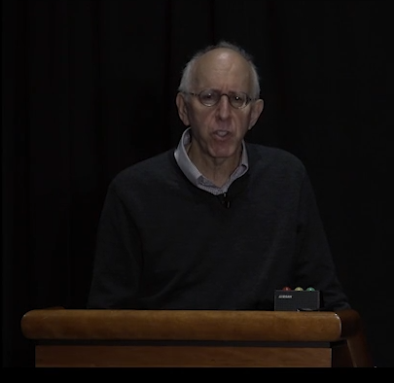
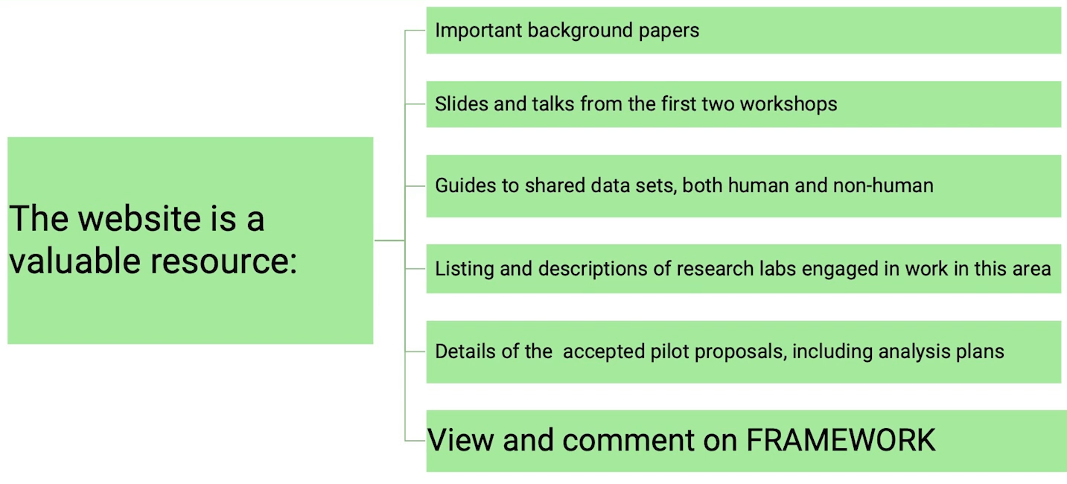
Yaakov Stern, PhD, Columbia University

Slide 3
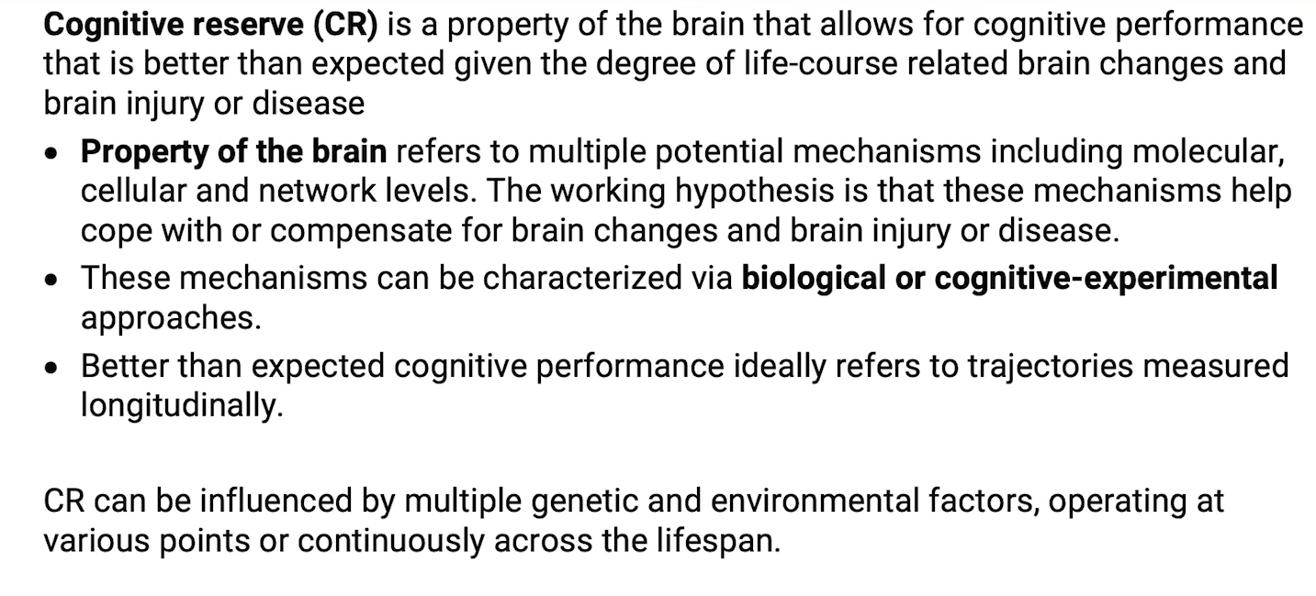
Yaakov Stern, PhD, Columbia University
大脑实际的认知表现比期待更好的一种能力，在伴随着life-course的大脑改变，或外伤，疾病的暴露

Slide 4
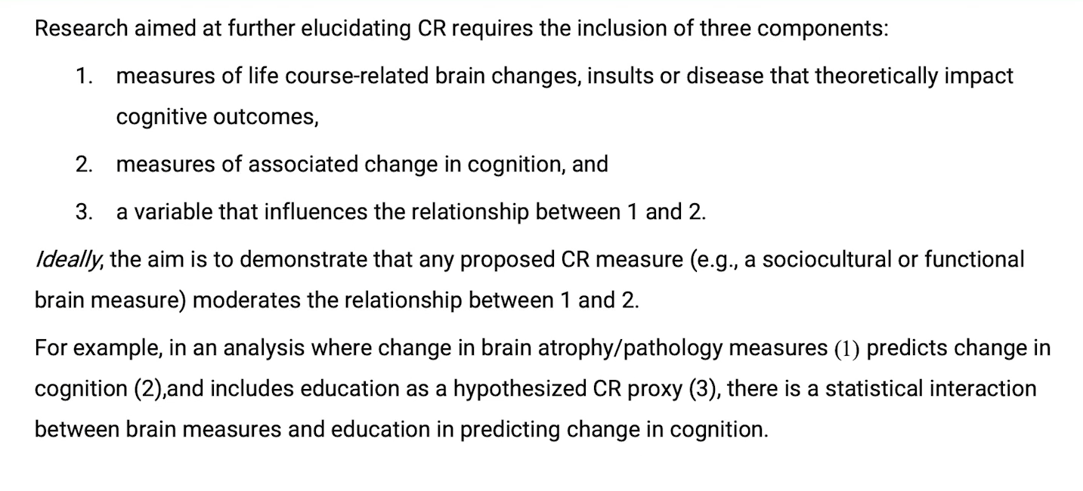
Yaakov Stern, PhD, Columbia University
Moderate the relationship between 1 and 2

Slide 5
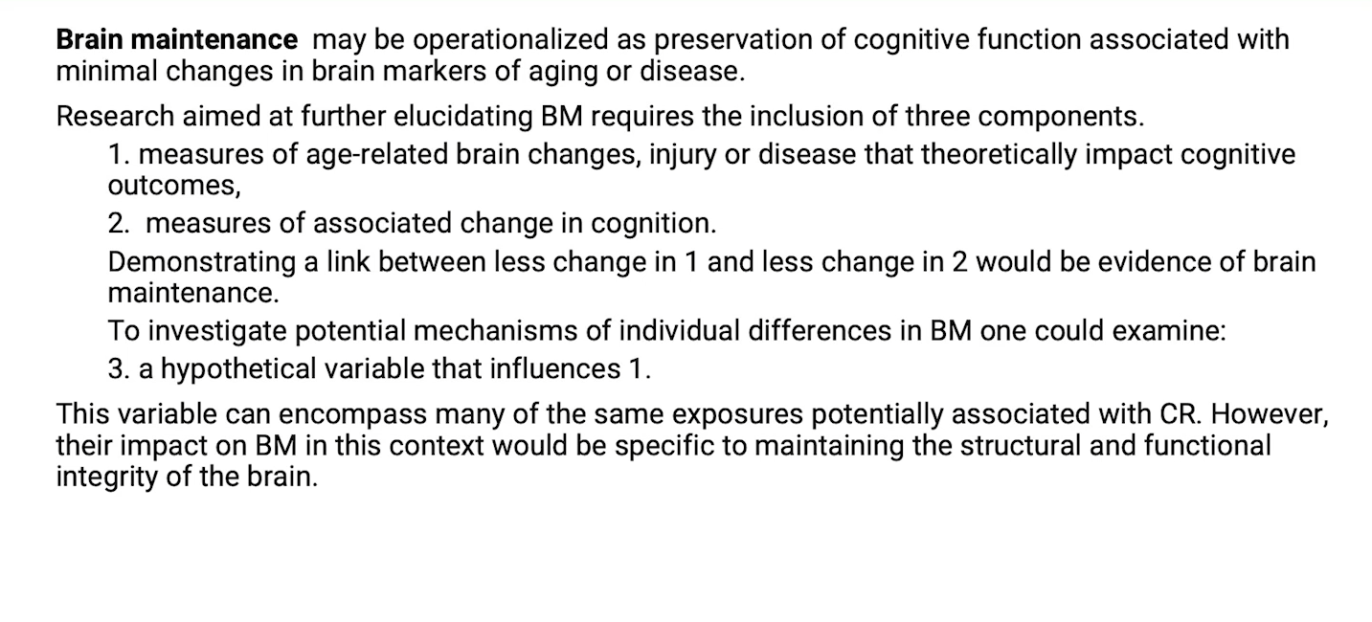
Yaakov Stern, PhD, Columbia University
BR的某些影响因素也和CR紧密相关
但是BR只是涉及到脑结构和功能的完整性

Slide 6
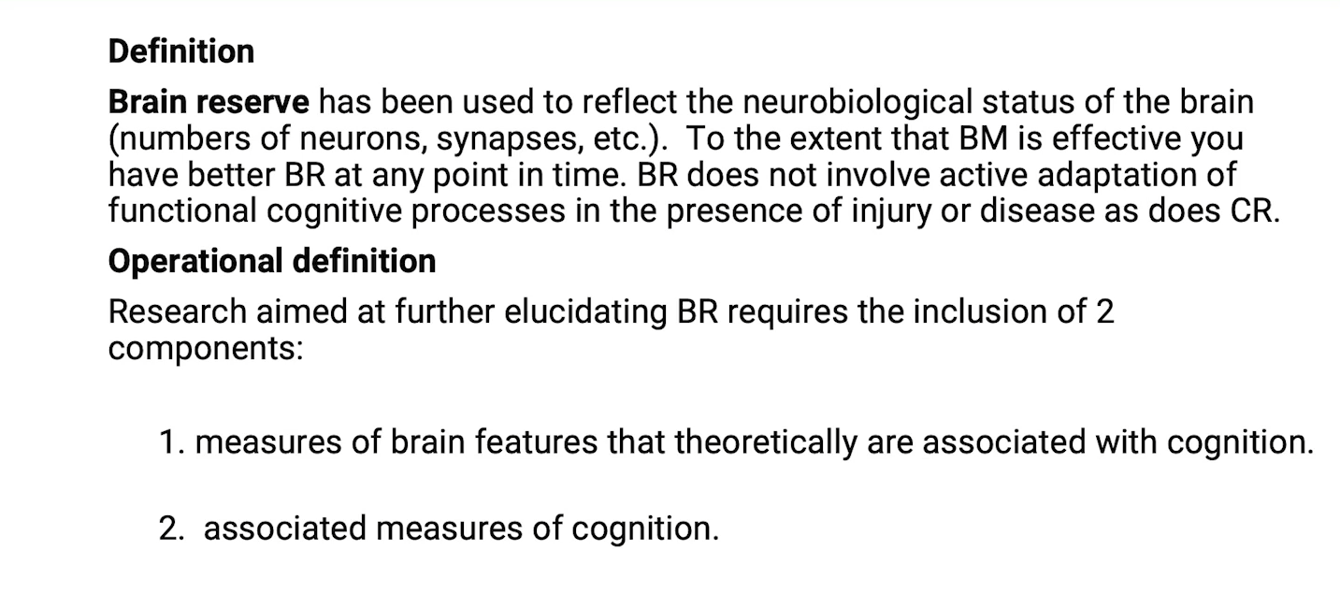
Yaakov Stern, PhD, Columbia University
“Neurobiological status”

Slide 7
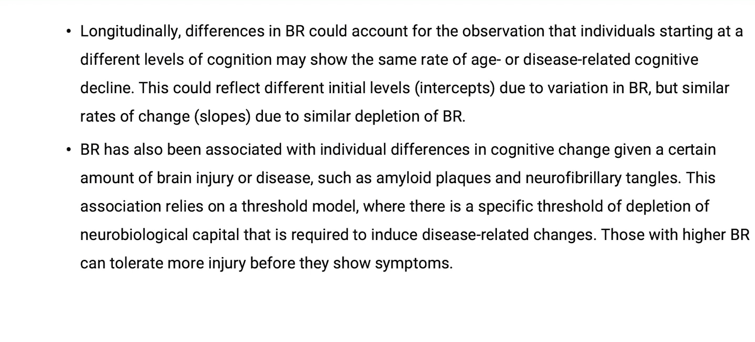
Yaakov Stern, PhD, Columbia University

Slide 8
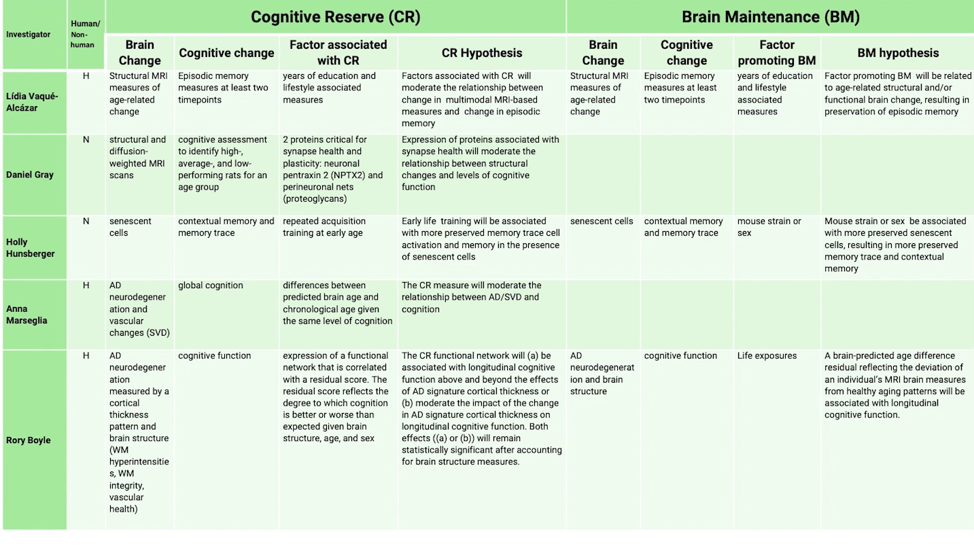

Slide 10
Aim1: Test hypothesis that educational training buffer against age-related cognitive decline in mice
Aim2: Test the hypothesis that there is a specific neural signature of cognitive reserve in ArcCreER^{T2} x EYFP mice

Slide 12
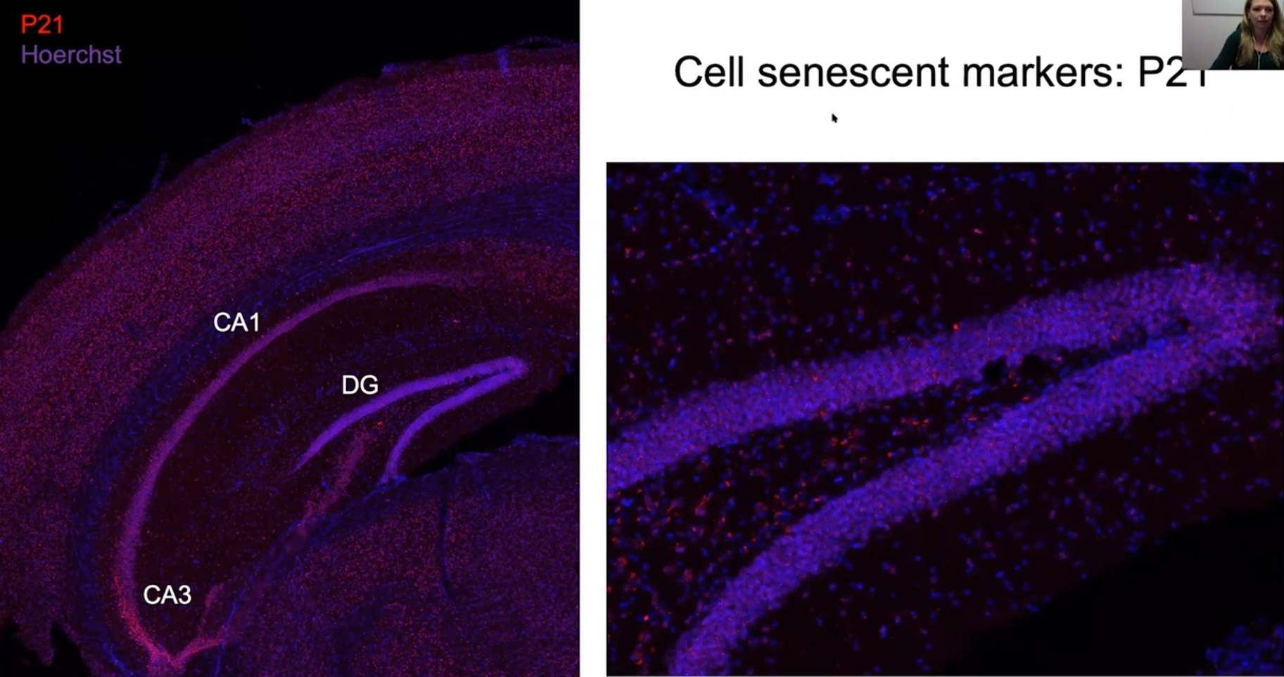
Cell senescent markers
延迟奖励能力

Slide 13
Cross-sectional and Longitudinal Relations between Educational Attainment and Brain Aging
Lars Nyberg, PhD, Umea University
4422 observations
2000 individuals
Cortical volume
Hippocampal volume

Slide 14
Cross-sectional and Longitudinal Relations between Educational Attainment and Brain Aging
Lars Nyberg, PhD, Umea University
Education relates to level of cognition and brain structure, not relate to the change
Support a link to brain reserve

Slide 15
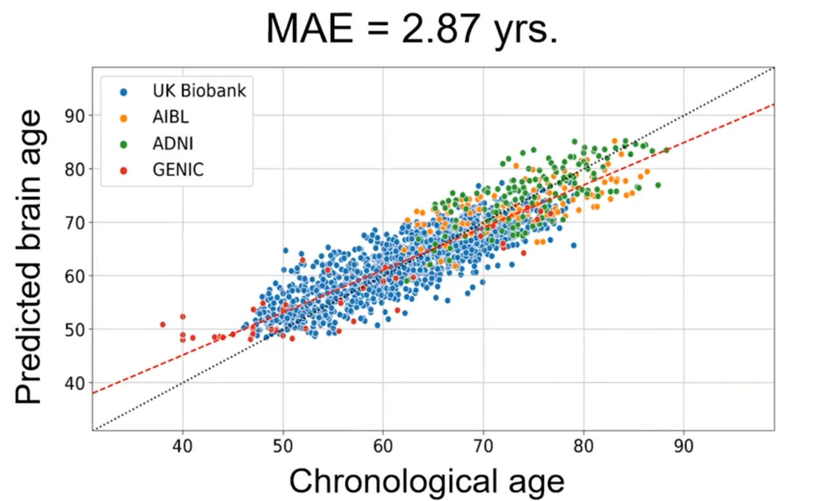
Developing a Biological Marker of Cognitive Reserve with Deep Learning from Multimodal Structural MRI
Anna Marseglia, PhD, Karolinska Institute
Association between PBA-CA and cognitive change over 5 years
Effect-modification analysis
Positive and negative factors associated with PBA-CA

Slide 16
Cognitive Resilience and Alzheimer Pathology in Normal Aging
William Jagust, MD, University of California, Berkeley
Dopamine Synthesis Capacity

Slide 17
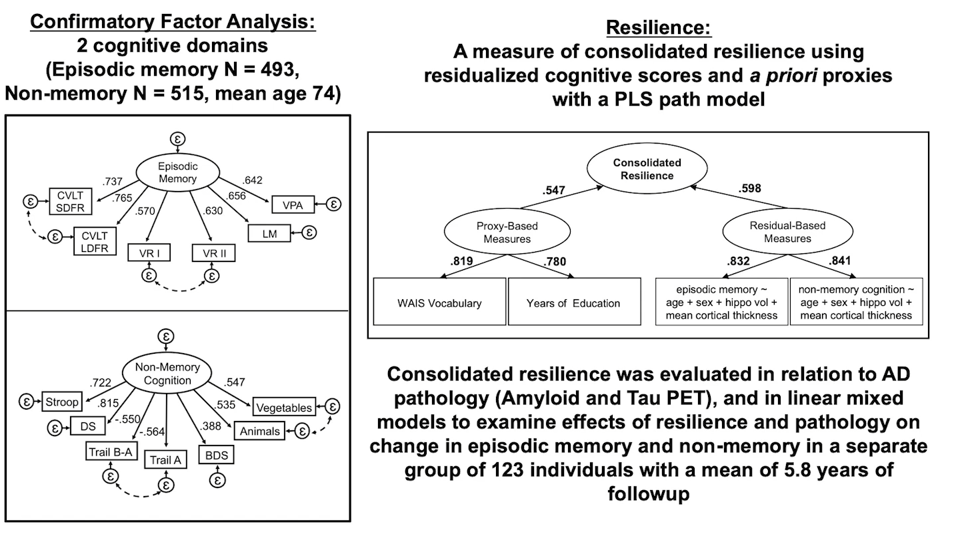
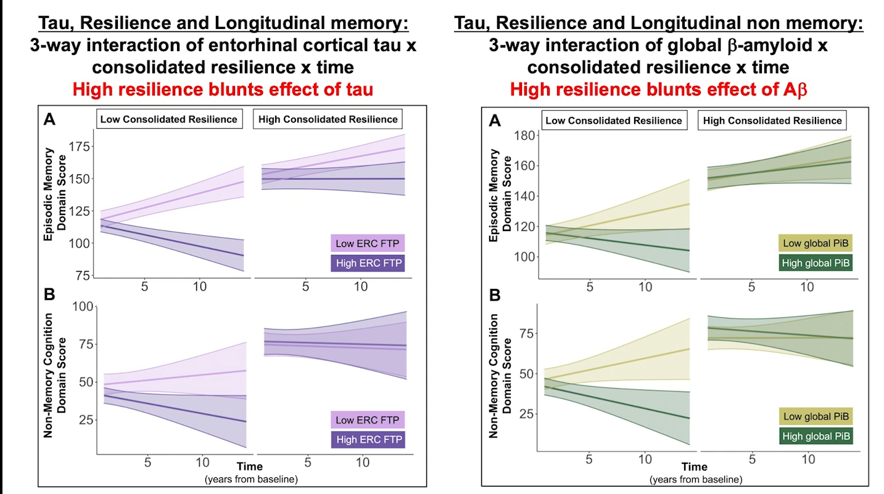
Cognitive Resilience and Alzheimer Pathology in Normal Aging
William Jagust, MD, University of California, Berkeley

Slide 18
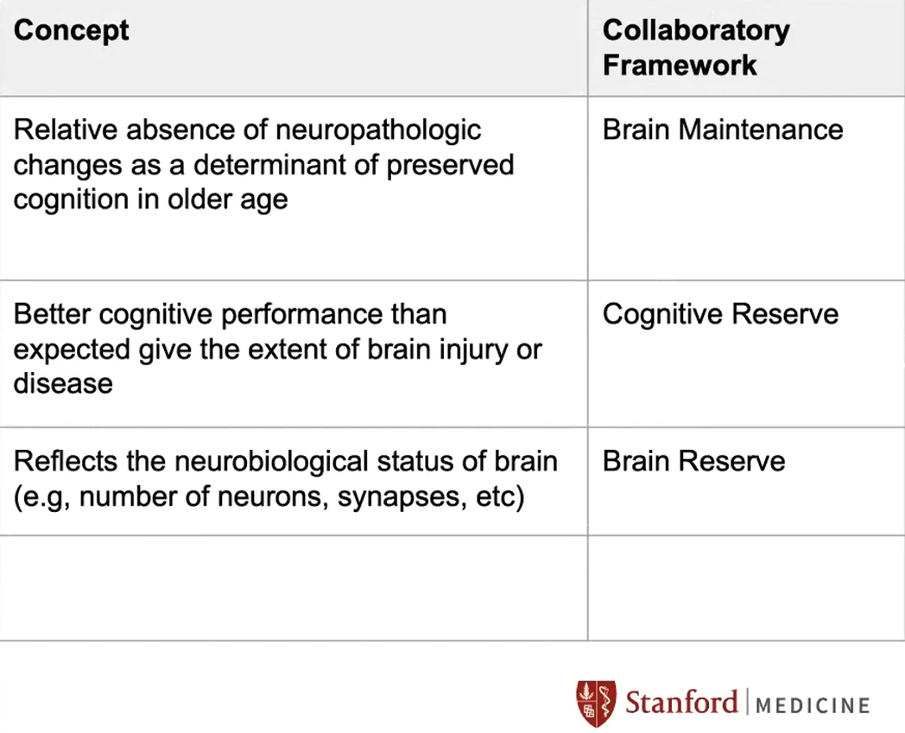
Integration of the Framework from other Perspectives: Neuropathology
Thomas Montine, MD, Stanford University
Framework
Neuropathology mapping of Framework

Slide 19
Framework in the Context of Resistance and Resilience Used in AD Biomarker Research
Prashanthi Vemuri, PhD, Mayo Clinic

Slide 20
Application of the Framework in Genetics
Timothy Hohman, PhD, Vanderbilt University Medical Center
胆汁酸代谢和磷脂转运过程

Slide 22
Thanks for your Listening

